Slide 1


Slide 2
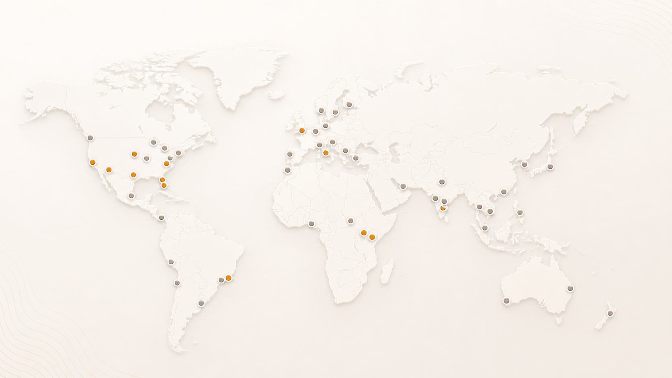
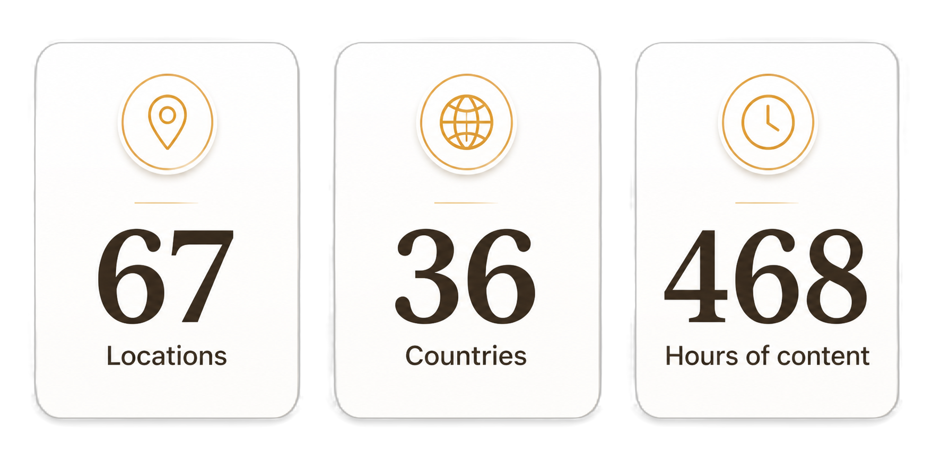
AgentCon around the world

Slide 3
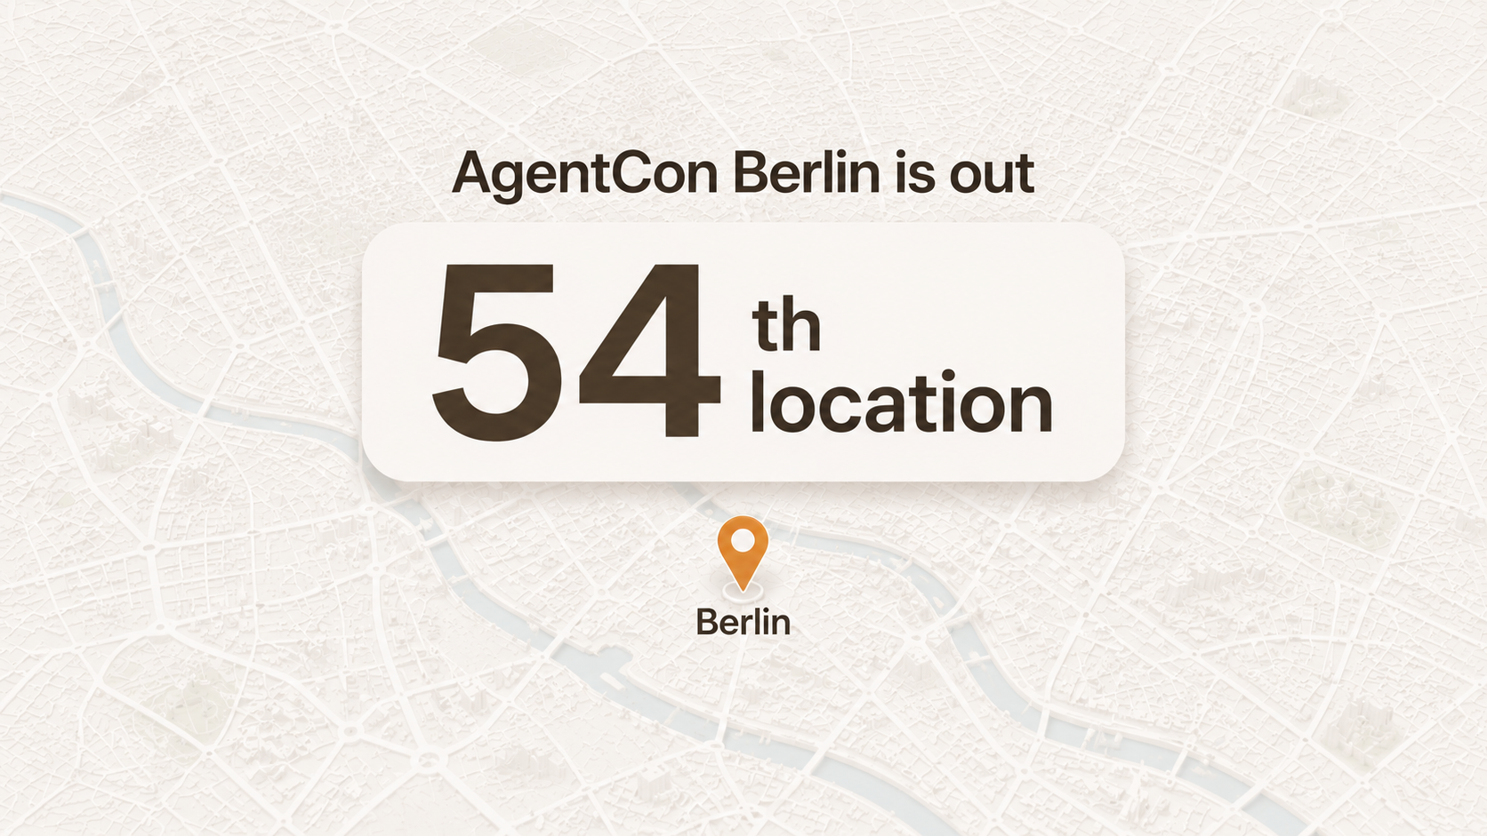

Slide 4


Slide 5
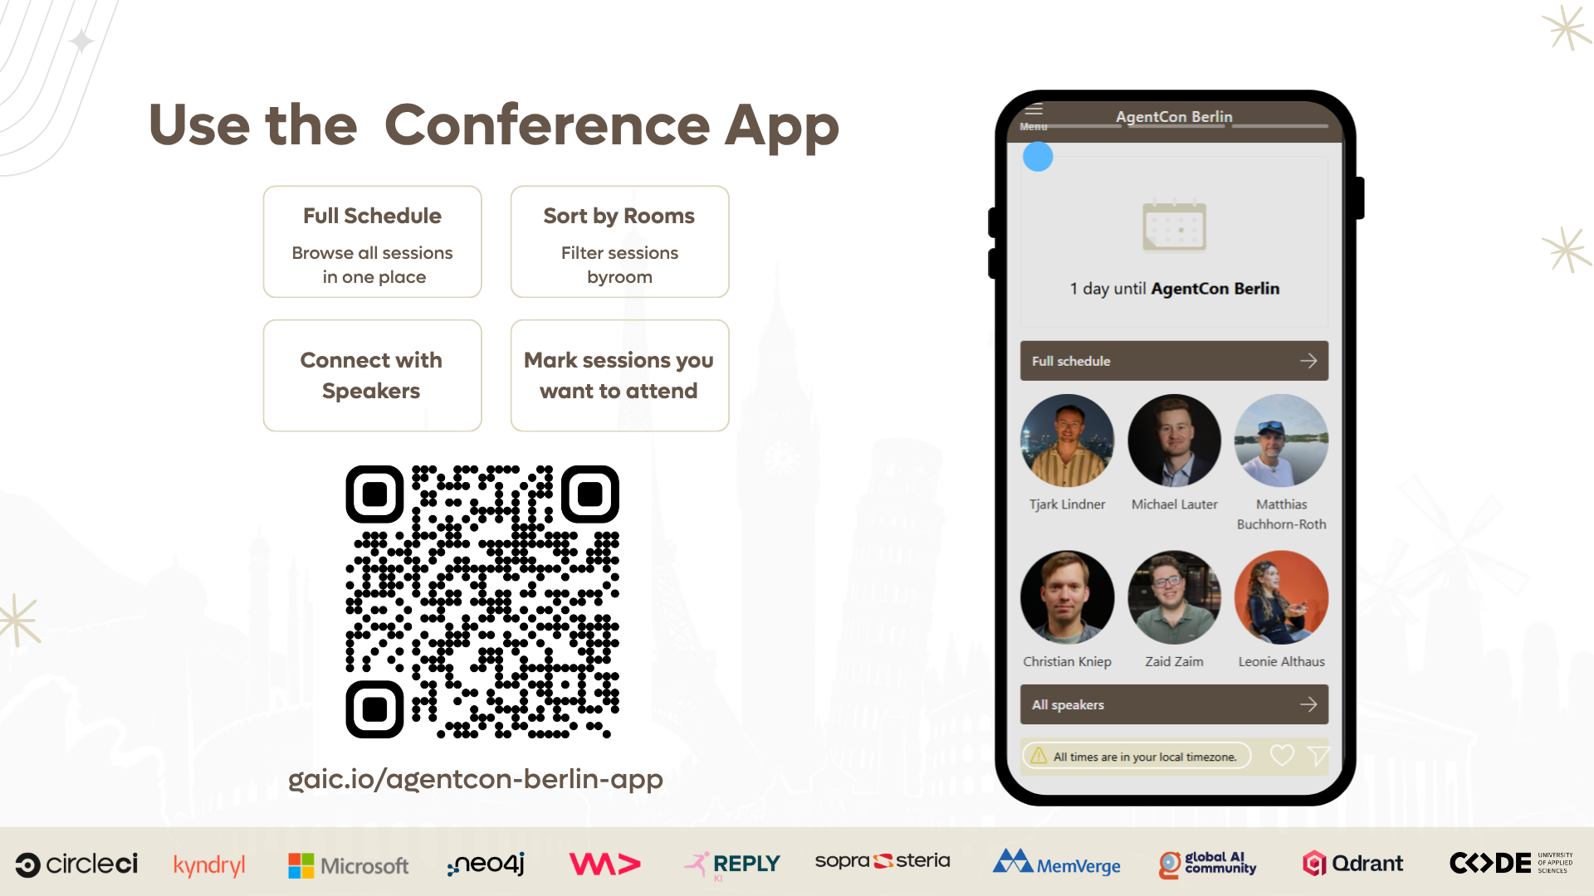

Slide 6
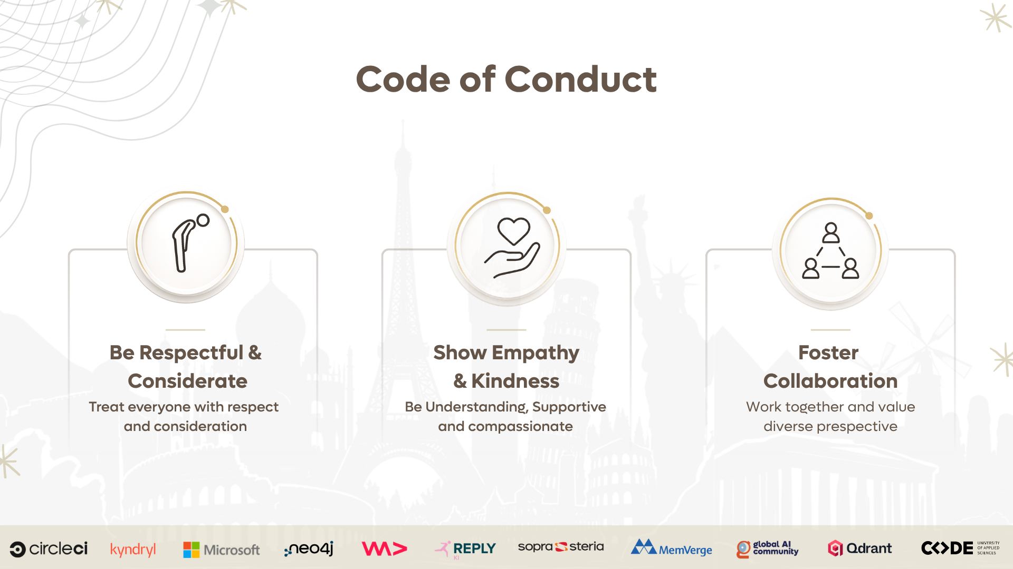
09:30 AM- 09:45 AM
Welcome and Opening
09:45 AM - 10:35 AM
Keynote: Lee Stott
TetRis
10:35 - 10:50PM
Coffee Break
TETRIS
DARKMATTER
10:50 AM – 12:15 PM
Sessions
10:50 AM – 12:10 PM
Sessions
12:15 PM – 01:00 PM
Lunch Break
12:15 PM – 01:00 PM (TetRis)
Keynote: Michael Hunger
01:55 PM – 02:50 PM
Sessions
01:55 PM – 02:55 PM
Sessions
02:50 PM – 03:10 PM
Break
03:10 PM – 05:10 PM
Sessions
03:10 PM – 05:15 PM
Sessions
05:15 PM – 06:00 PM
Networking, Raffles at Level Six Rooftop

Slide 7
09:15 AM
09:30 AM
Welcome Note
09:30 AM
10:20 AM
Keynote
Henk Boelman
THEATER
WORKSHOP SPACE
10:30 AM – 12:25 PM
Sessions
10:30 AM – 11:55 PM
Workshop
12:30 PM – 01:30 PM
Lunch
01:30 PM – 02:55 PM
Sessions
01:30 PM – 03:00 PM
Workshop
03:00 PM – 03:15 PM
Break
03:15 PM – 05:10 PM
Sessions
03:15 PM – 05:15 PM
Workshop
05:15 PM
The Grand Closing: Raffle & Community Quiz

Slide 8

Join the AI Conversation on Discord
gaic.io/discord

